Slide 1
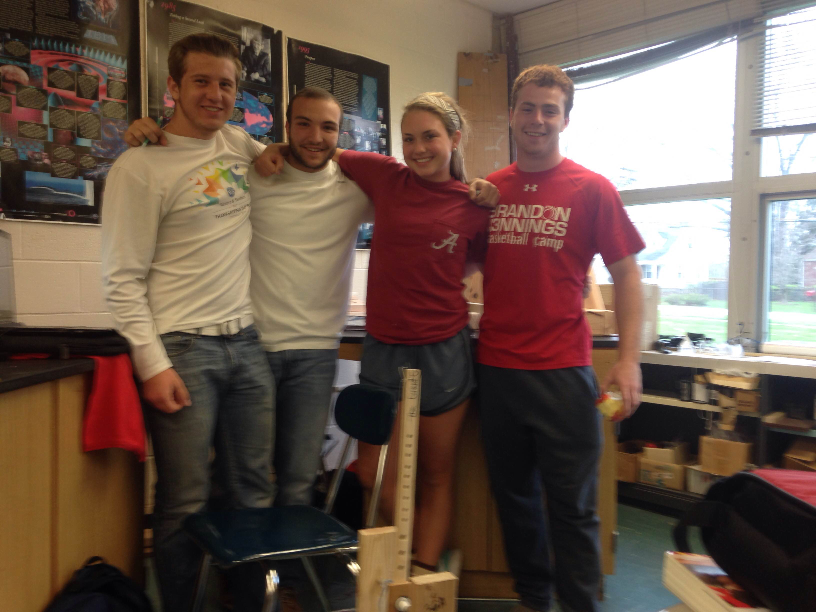
Trebuchet Project
Kyle Greuach, Tony Tufano, Katie Brulport, Grant Gallagher

Slide 2
Understand
We read the design requirements on the Trebuchet competition site
We saw that the maximum dimensions from last year were bigger than the dimensions from this year
We started to understand the requirements and got to work

Slide 3
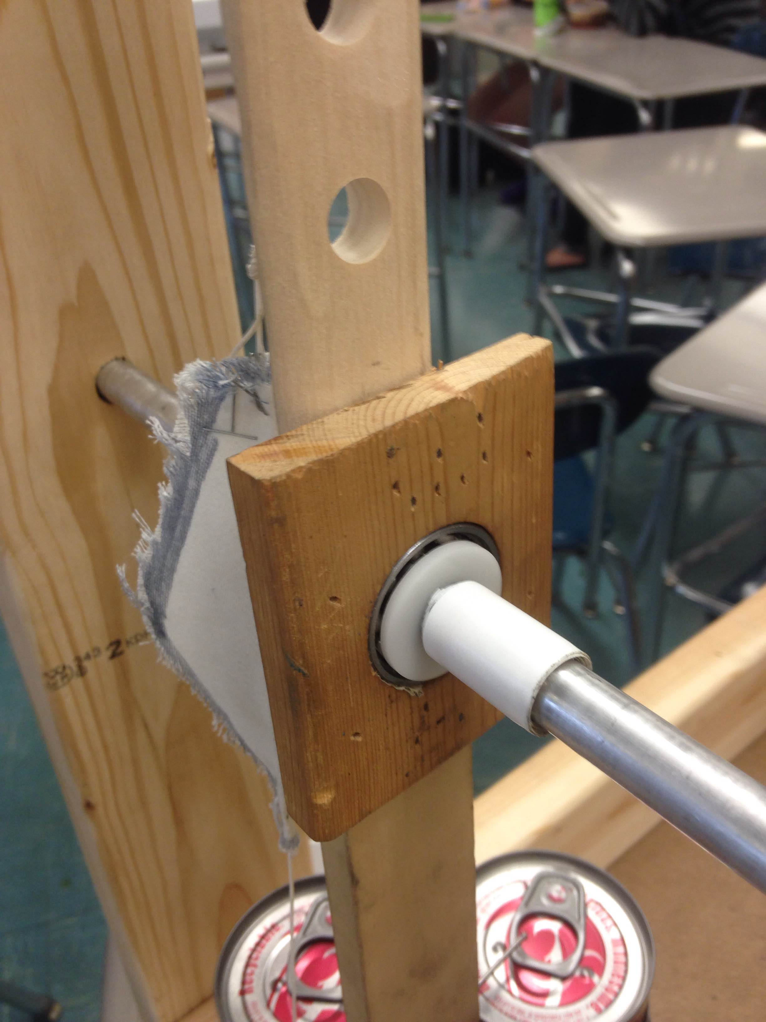
Explore
We explored the closest in the back of the science wing and found our arm from last year
We tried to develop a plan to use last year’s arm in this year’s new one
We wanted to use the same ball bearing idea that worked so well last year

Slide 4
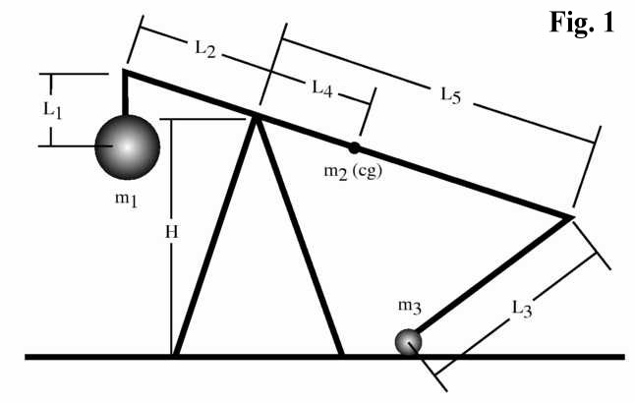
Define
The design rules can be found at: http://cecs.wright.edu/students/activities/trebuchet/rules/design

Slide 5
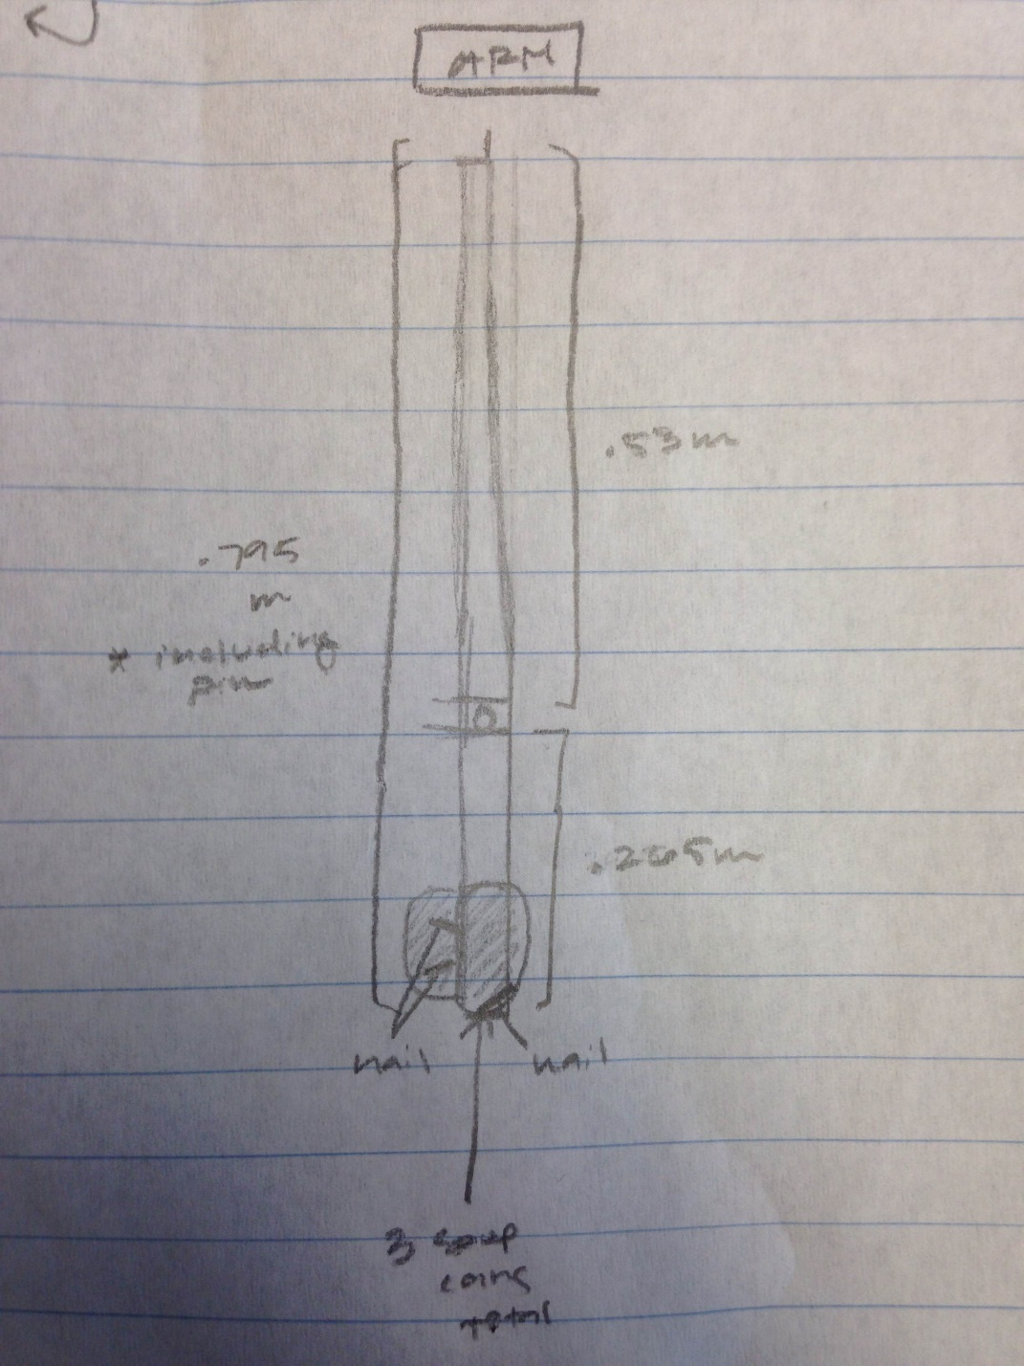
Ideate: Top and Arm Views

Slide 6
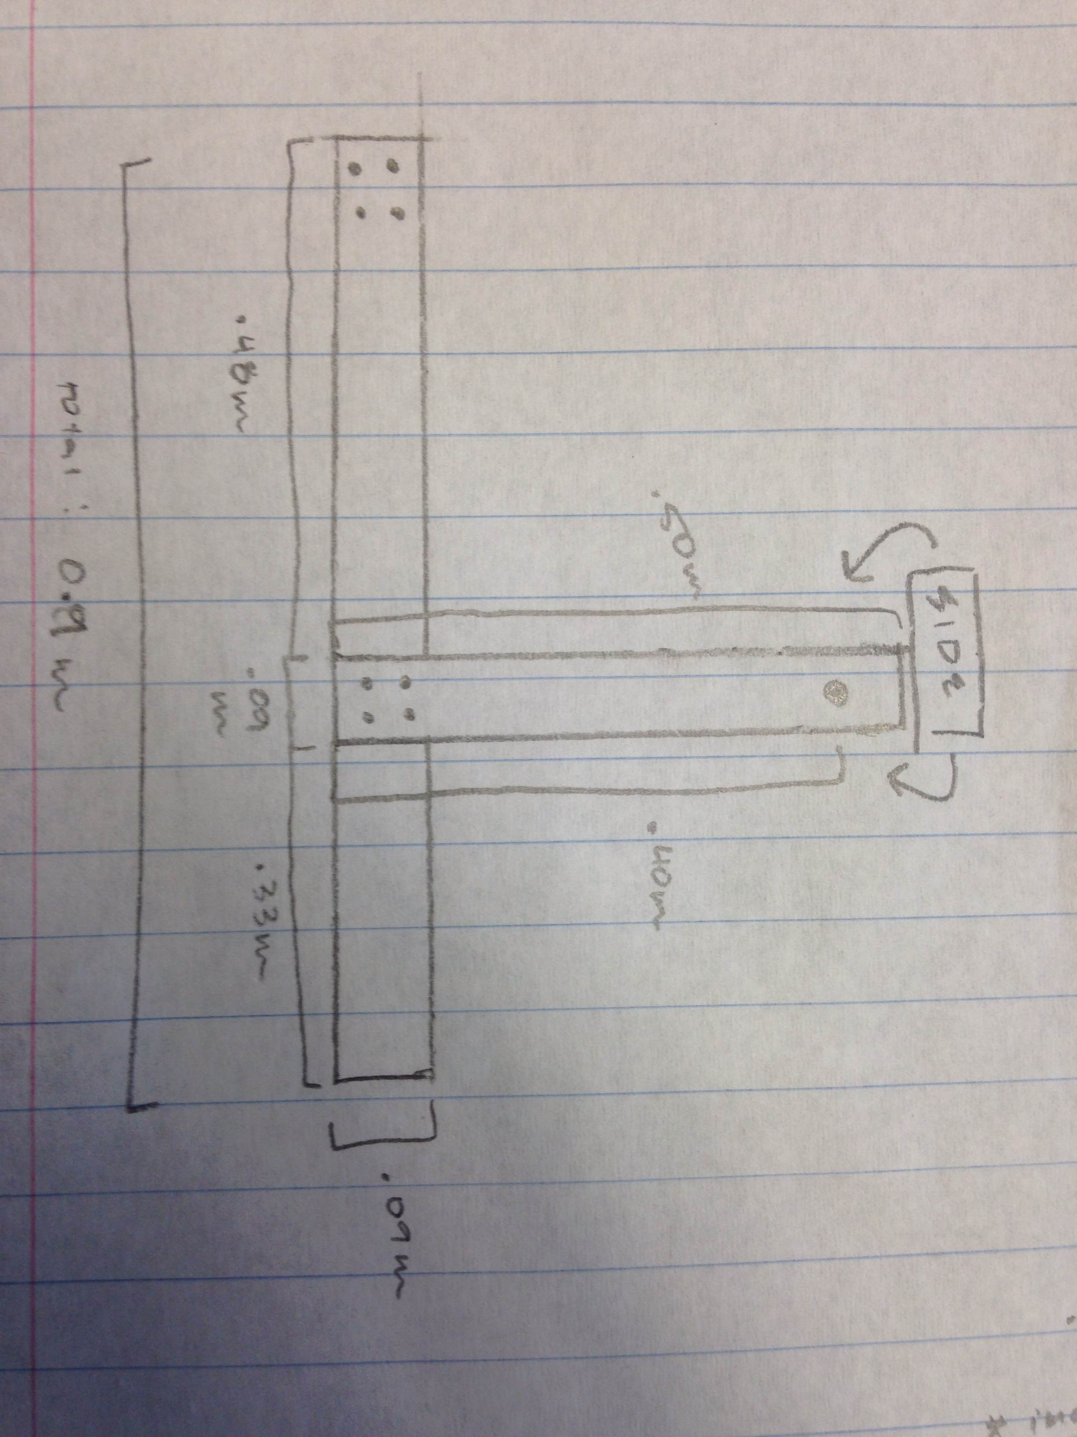
Ideate: Side View

Slide 7
Prototype

Slide 8
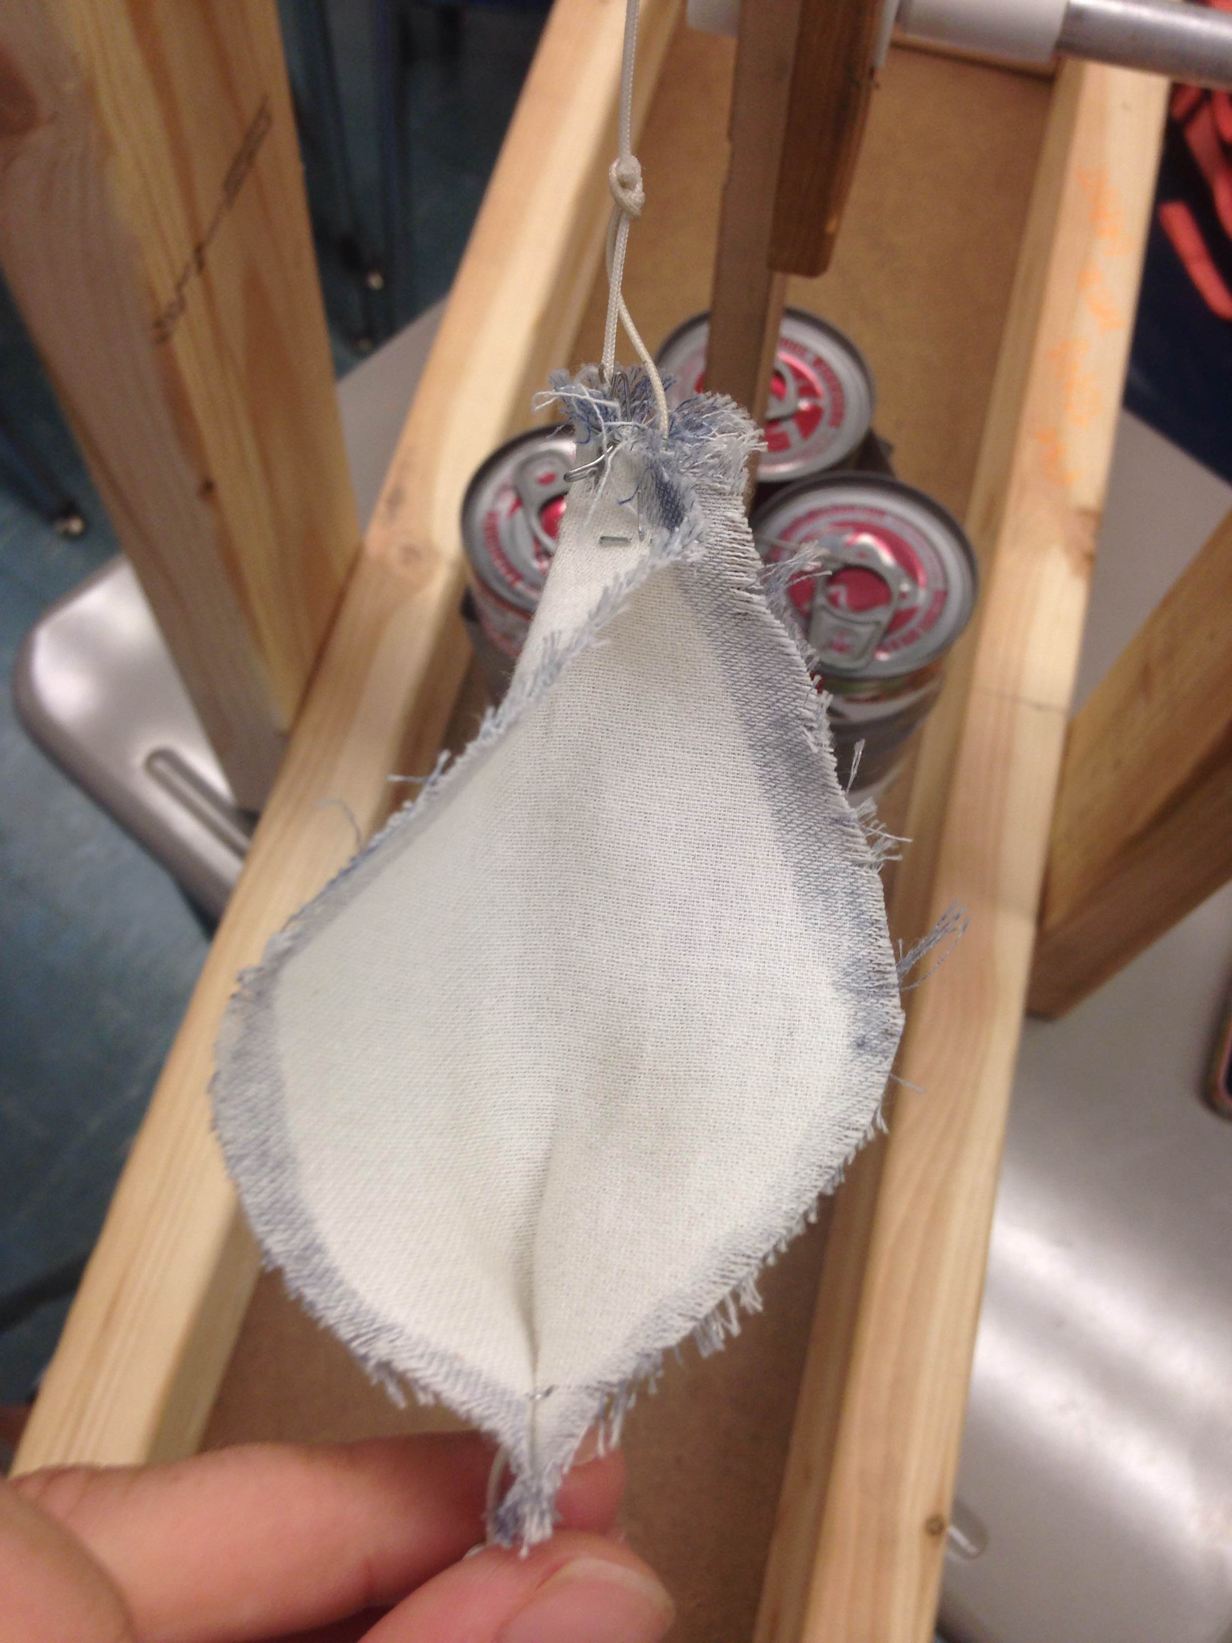
Prototype

Slide 9
Building
We built the base out of wood in a rectangle shape with one of the small sides left out.
We built a T-shape out of wood to support the axle that we put a little lower than 40 cm from the ground.
We then took our arm from last year and cut it down on both sides to make it 80 cm and included the length of the pin.
We had the pouch and string already connected to the original arm, so we just took it off and reattached it the newly cut down arm

Slide 10
Refine
After building our trebuchet, it didn’t work exactly the way we wanted to, but it did work very well compared to the other trebuchets built in our class in the beginning
We had to change the pin angle on the end of the throwing arm to get the optimum angle of 45 degrees on the release
Our pouch to hold the ball was very loose so we stapled it a couple different ways so it would throw the ball and not hold it in the pouch
We also took weight out of the top part of the arm so that the two sides of the arm would be closer in weight. To do this, we drilled holes up and down the arm

Slide 11
Test Results and Fixes
Accuracy: Most accurate throw was 37 inches away from the target that was 30 feet away from the axle of the trebuchet
Distance: Farthest throw was 37’5”
The change we could have made was bending the top nail backward to get a little close to the 45 degree angle sought after because our arm seemed to throw more like 35-40 degrees from ground level.
We could have also changed our pouch. Our pouch was the same as last year with a few modifications, but in the end, a whole new pouch and design might have worked better since every once in a while, some of the throws remained in the pouch during the follow through of the arm.

