Slide 1
Parachute Project
By Kyle Greulach and Grant Gallagher

Slide 2
Understand
We had to build a parachute that had to land an egg safely on the ground without cracking the egg totally open
The egg was to be dropped from the top window of the chorus room

Slide 3
Explore
We knew we had to use something lightweight so the parachute wouldn’t topple over the egg and go down backwards so we used a garbage bag for our parachute
We also used paper because it was lightweight and could hold an egg with a piece of tape holding the egg from the bottom

Slide 4
Define
We needed to go with the most lightweight design we could, but also sturdy enough not to break
We had to hold the parachute in a compartment and have it deploy by using a second parachute that caught enough air to pull out the main parachute from the compartment

Slide 5
Ideate
We used a funnel made out of paper as our parachute holding compartment
We used a square parachute in the beginning hooked up the 4 strings that all connected to the bottom of the funnel
A cylindered compartment held the egg in place with a piece of tape under it

Slide 6
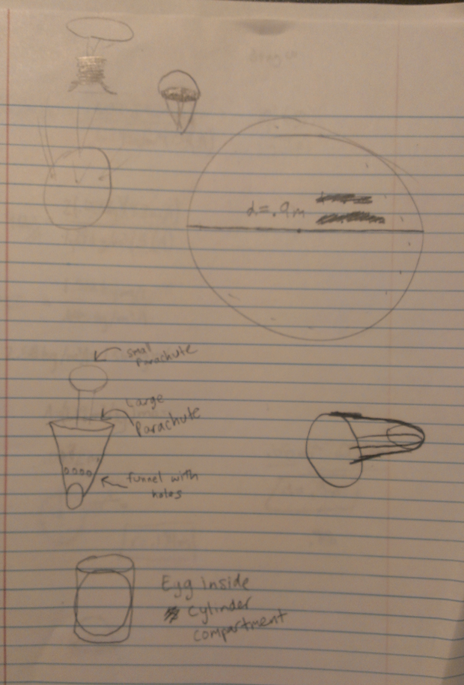
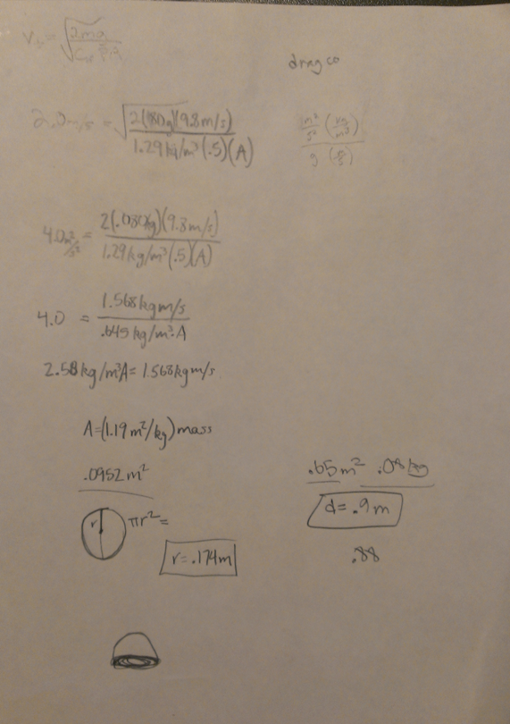
Drawings and Equation

Slide 7
Refine
After testing the square parachute, we decided that it wasn’t going to deploy… even with the second parachute
We designed a whole new circle parachute the following day
We used the same funnel concept, but instead of 4 strings, we used 8, and connected them to the top of the funnel instead of the bottom

Slide 8
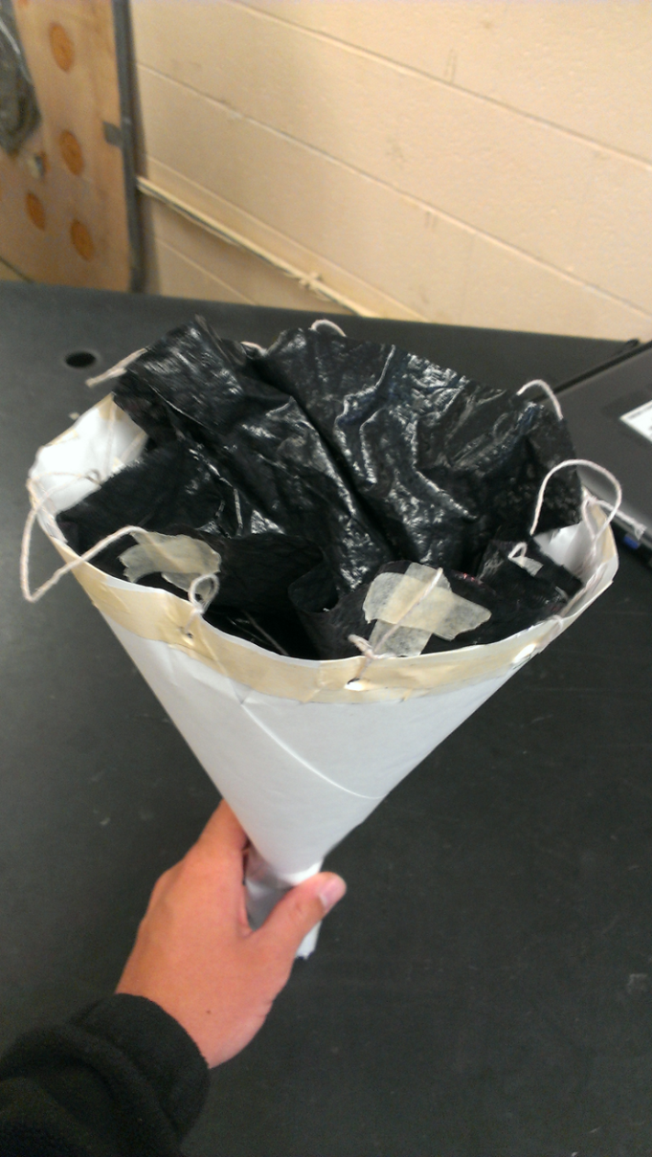
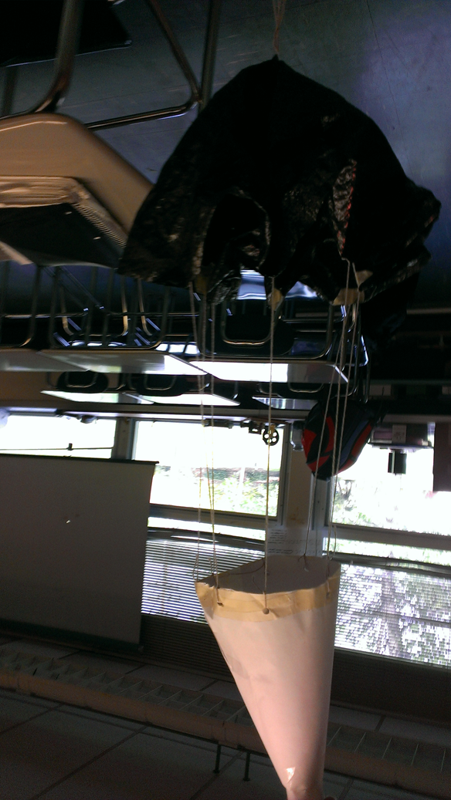
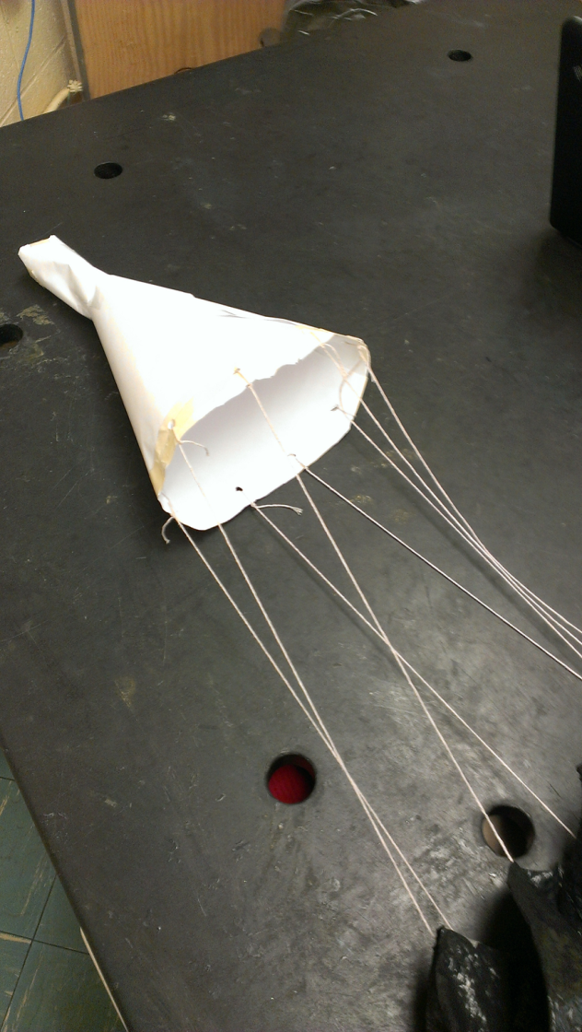
Final Product

Slide 9
Test Results Chart
Drop # | Drop Height (m) | Drop Time (s) | Descent Rate distance (m)/time (s) | Surface area of parachute (m^2) | Weight of system (N) | Theoretical Terminal velocity (m/s)
1 | 9m | 6.5s | 1.38m/s | 1.13 m^2 | 1.1 N | 1.7 m/s
2 | 9m | 6.7s | 1.34m/s | 1.13 m^2 | 1.1 N | 1.7 m/s
3 | 9m | 6.6s | 1.36m/s | 1.13 m^2 | 1.1 N | 1.7 m/s

Slide 10
Results Discussion
Our egg landed safely and did not break on all three attempts
The egg cracked because it hit the side of the building the first throw
The second throw, the egg landed on the grass and had no damage
The last throw, the wind caught the parachute and the egg hit the concrete, the egg did not break open, but had lots of cracks in it

Slide 11
Rating
I would say that our first parachute design was a 3, we had the funnel concept down, but the deploying of the parachute did not work at all and the wires tangled
The second parachute would have to be a 9.5, we nailed our idea of a circle parachute and the egg survived all three times. The only reason I don’t give this a ten is because the egg did crack a little when hitting the concrete

