Slide 1
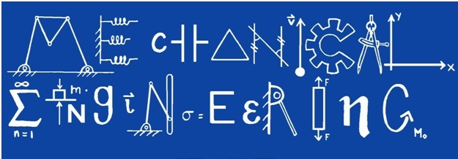
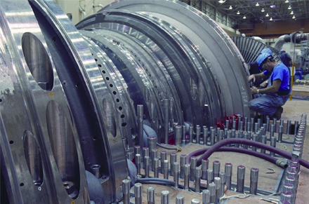
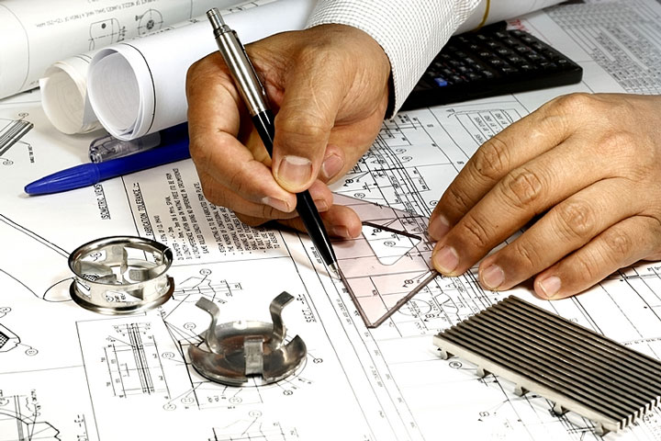
By: Kyle Greulach

Slide 2
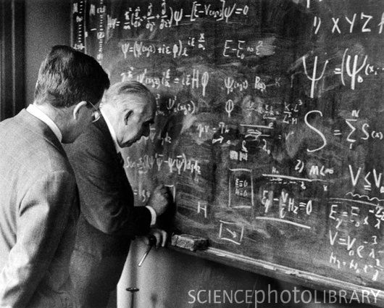
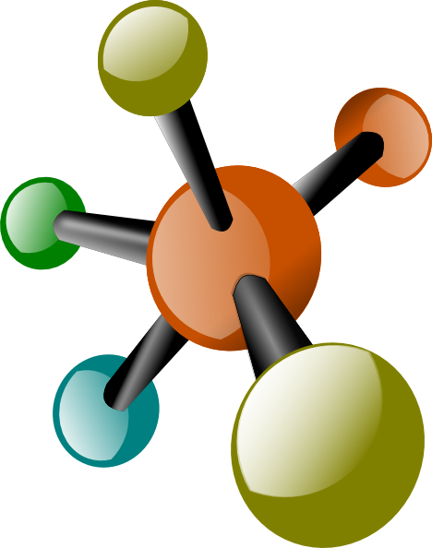
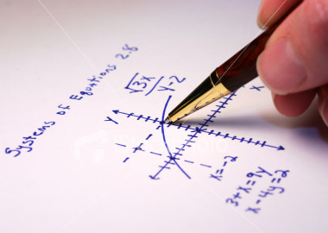
Entering the Field
Basically, a Mechanical Engineer uses math and science to find technical solutions for problems such as design, construction, and manufacturing.
An engineer in general should take as many math and science classes as possible in high school. Computer science is also preferred among incoming engineers. Physics, Calculus, Algebra, and Chemistry are a few examples of classes to take in high school.
According to salary.com, the median expected salary for a Mechanical Engineer is $61,702 a year

Slide 3
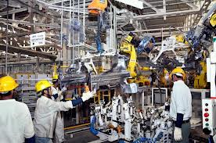
Nature of the work and jobs
Videos
Daily Life of a Mechanical Engineer
Mechanical Engineering
Mechanical engineering is the most general form of engineering. They learn a little bit of everything that goes into the field of engineering. Mechanical engineers can develop and build anything from a small child’s toy to an aircraft carrier.

Slide 4
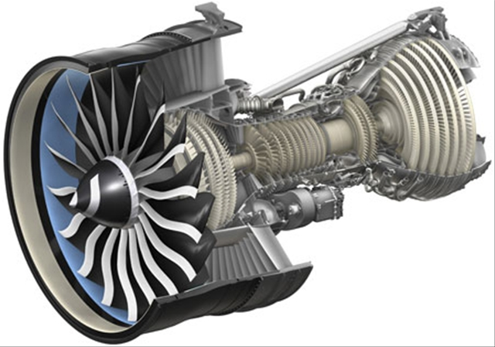
General Electric (GE)
http://www.ge.com/
GE is one of the world’s largest engineering companies. They make all types of things such as appliances, software, transportation, electricity, and airplane engines. My parents are both engineers at GE with degrees in Aerospace and Mechanical engineering. They work on designing, processing, and testing airplane and jet engines.
GEnX Engine Building and Testing Video

Slide 5
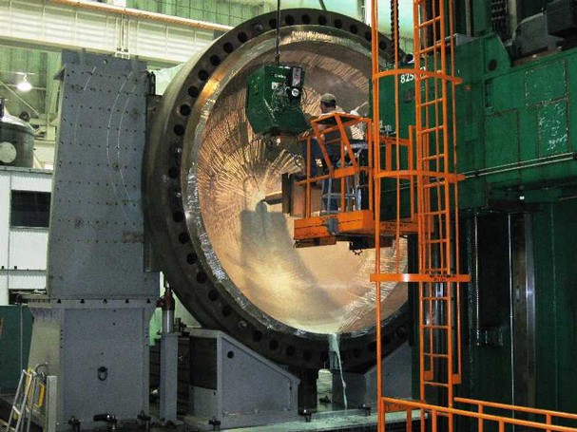
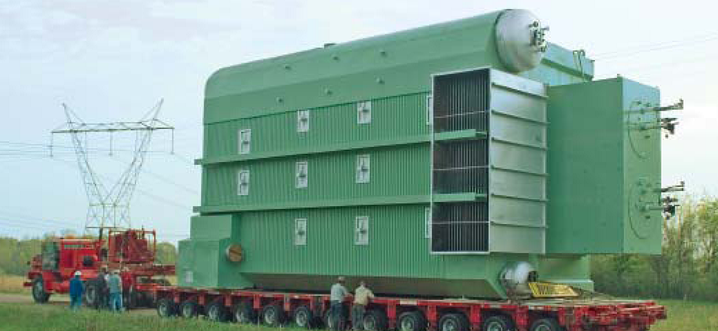
The Babcock & Wilcox Company
http://babcock.com/
The Babcock & Wilcox Company produces many products but is most famous for producing boilers. Boilers are basically steam generators that use heat to convert water into steam for a variety of applications. They are mainly used for electric power generation and industrial process heating though. The Babcock & Wilcox Company also work a lot with nuclear energy and build commercial nuclear plant components as well as nuclear reactors.

Slide 6
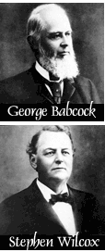
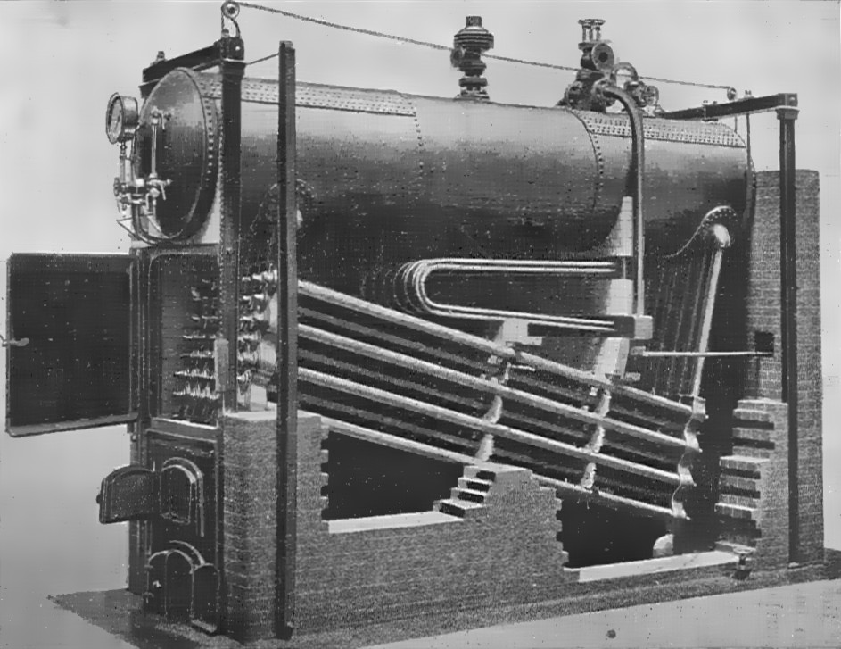
George Babcock
George Babcock was an American inventor. He and Stephen Wilcox co-invented a safer water tube steam boiler, and founded the Babcock & Wilcox Boiler Company.
Babcock's water tube steam boiler provided a safer and more efficient production of steam, and was built to work better under higher pressures than earlier boilers. In 1881 their company was incorporated. Babcock was the president and Wilcox was the vice president.
In 1997, George Babcock was inducted into the National Inventors Hall of Fame

Slide 7
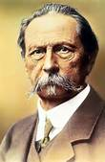
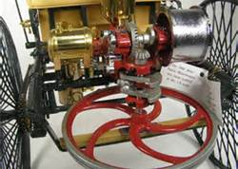
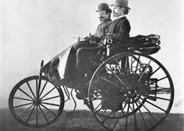
Karl Benz
Karl Benz is a German engine designer and car engineer. He is regarded as the inventor of the gas-powered automobile.
Benz began his work on a two-stroke engine, in hopes of finding new income. He received his first patent in 1879. In 1883 he founded Benz & Company to produce industrial engines. He worked on a four-stroke engine which was his “motor carriage”. H designed the engine for a three-wheeled vehicle with an electric ignition, differential gears, and water-cooling. He received a patent for it and in July of 1886, he sold his automobile to the public.
The company was later named Mercedes-Benz after a 1901 Mercedes by Daimler, and Karl Benz’s first automobile in 1886. The 1886 automobile is said to be the first one ever.

Slide 8
http://education-portal.com/mechanical_engineer.html
http://www1.salary.com/Mechanical-Engineer-I-Salary.html
http://www.discoverengineering.org/
http://www.ge.com/
http://babcock.com/
http://www.youtube.com/watch?v=76KyYo0DmUw
http://www.youtube.com/watch?v=Z5hAy81iDBA
http://www.youtube.com/watch?v=sv5C5I67SNA
http://inventors.about.com/library/inventors/blbenz.htm
Bibliography

