Slide 1
iPhone Case Presentation
By: Kyle Greulach

Slide 2
The Design Thinking Process
Understand
Explore
Define
Ideate
Test
Refine
Solution

Slide 3
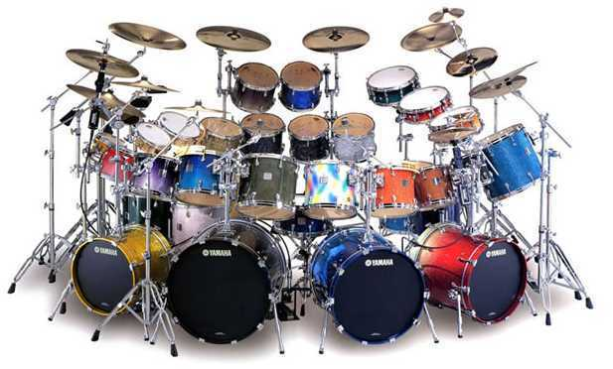
Understand
Joe
Likes drums
Percussionist
Favorite color: Blue
Needs something durable to listen to music to and drum as well
Needs the phone to not break if dropped which happens frequently while playing drums

Slide 4
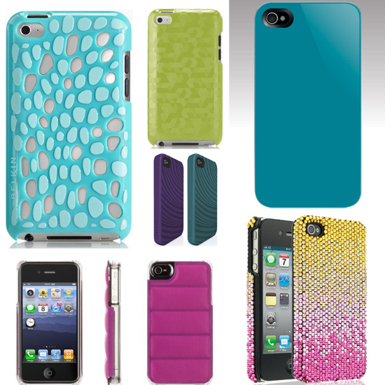
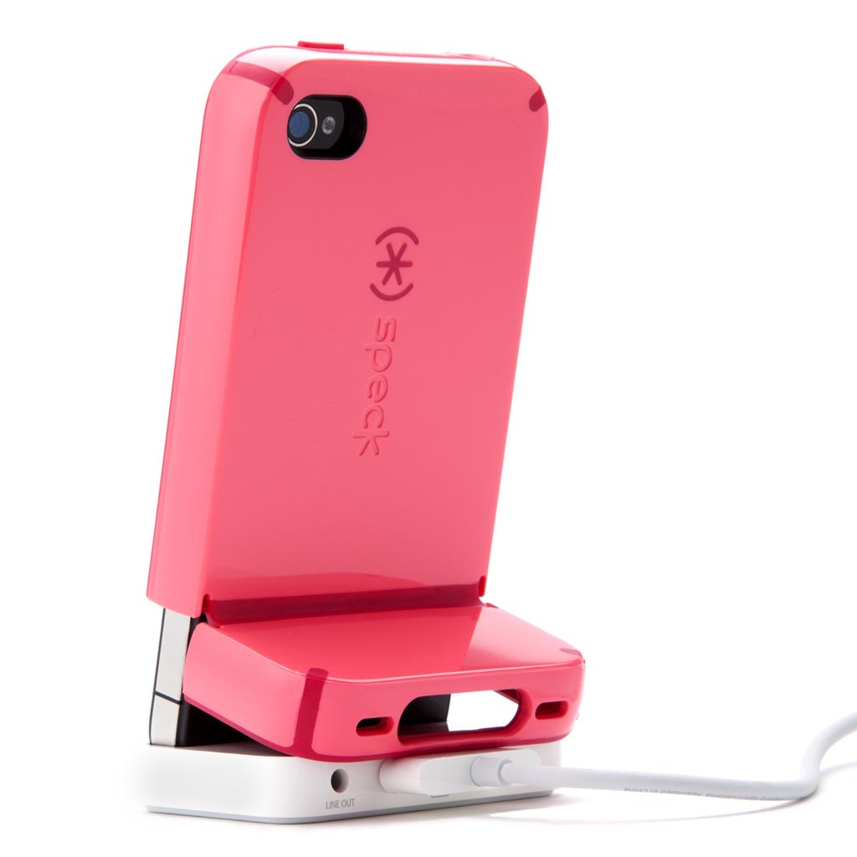
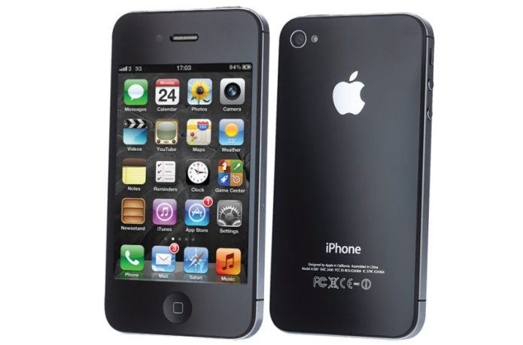
Explore

Slide 5
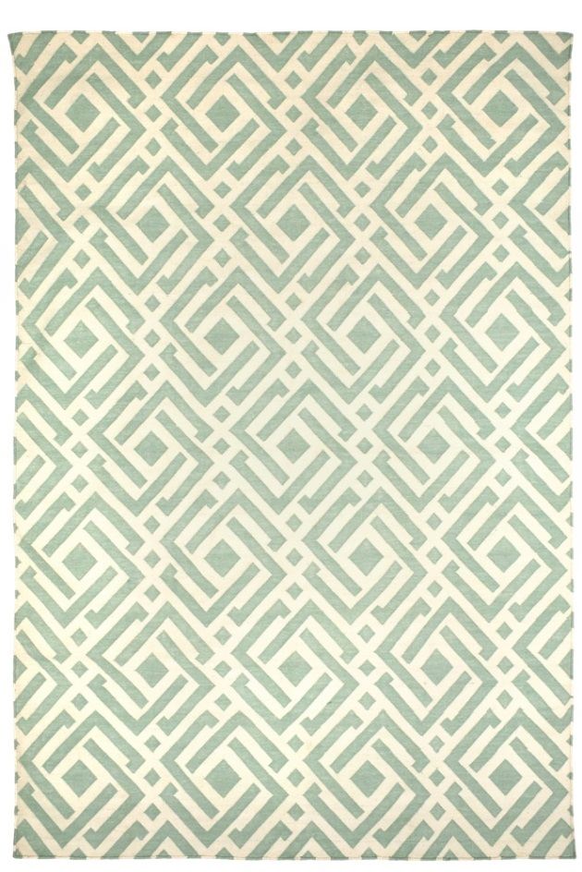
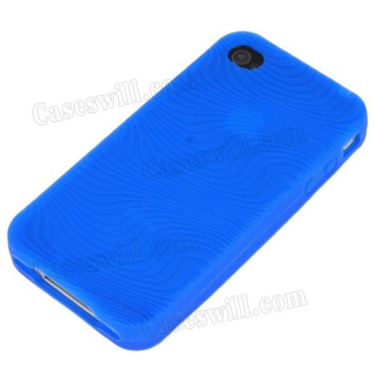
Define
Wants:
iPhone 4S Case
Blue Color
Thin
Cool Geometric Design
Simple Design
Make sure there are holes for buttons and plugs
Durable when drumming

Slide 6
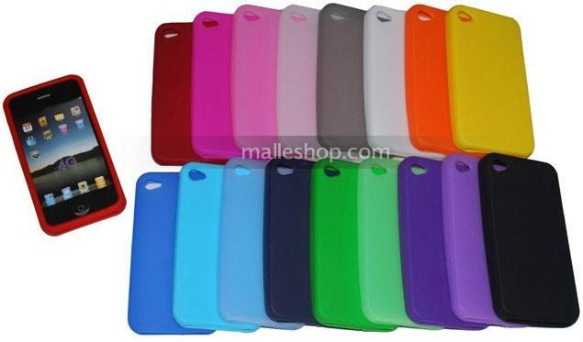
Ideate
Made of Silicone
Why?
Silicone is a half and half between rubber and a hard plastic. The silicone will be the most durable because the hard plastic case would break if dropped, but still hold the phone, and a rubber case would break the phone, so the silicone will protect the phone as well as a case that doesn’t break.
Silicone also is good for gripping. Hopefully the phone will stick to the customers pocket while he is drumming and won’t fall out or slip out easily.

Slide 7
Refine
Test

Slide 8
Solution

Slide 9
Inventor Studio Rendered Images

Slide 10
Inventor Studio Rendered Images

Slide 11
Parts View

Slide 12
Back View

Slide 13
iPhone Parts
Assembly
Video
iPhone
Rotation
Video

Slide 14
Parts with Balloons Blueprint

Slide 15
Top Blueprint

Slide 16
Bottom Blueprint

