Slide 1
Wind Turbine Project
By: Neil Berg, Kyle Greulach, and Bill Pahutski

Slide 2
Understand
We were wondering if wind turbine blades were more effective than others.
We wanted to clarify whether or not different materials and curvature made a difference in performance.
We decided we would have to build our own wind turbine, at a manageable level to test our question.
First, we needed to understand more about wind turbines to establish a knowledge base.

Slide 3
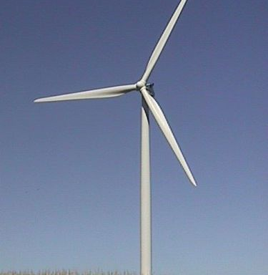
Explore
We looked online to find out all we could about wind turbines and wind energy.
We found a website that told us how to build a basic wind turbine, that wasn’t too much money, but produced sufficient data.

Slide 4
Define
Materials- Balsa wood, PVC pipe and fittings, tinker toys, Construction tools, hammers, small saws, scissors, exacto knives, glue guns, PVC cutters
Procedure- attach the metal and balsa wood blades and test them on the fan settings to determine the electrical output of the different blades spinning
Full Procedure at- http://learn.kidwind.org/learn/science_fair_projects

Slide 5
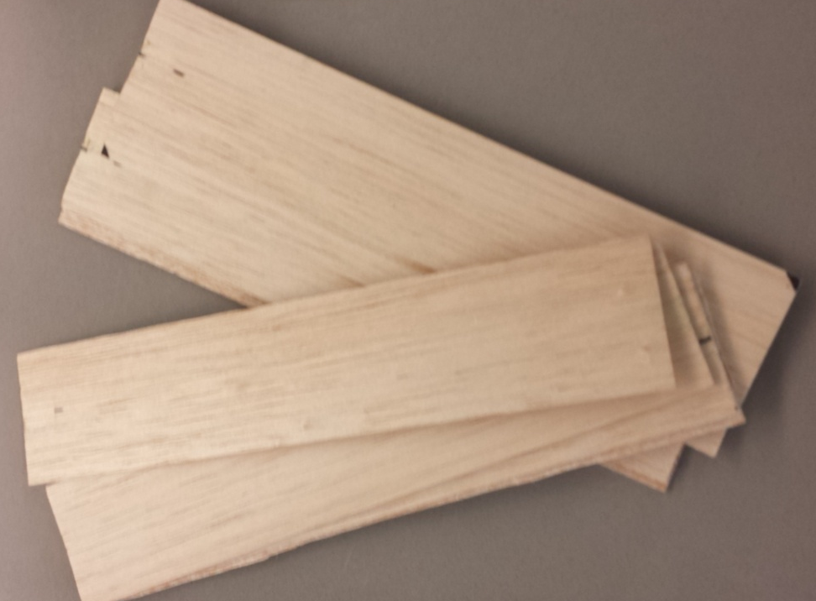
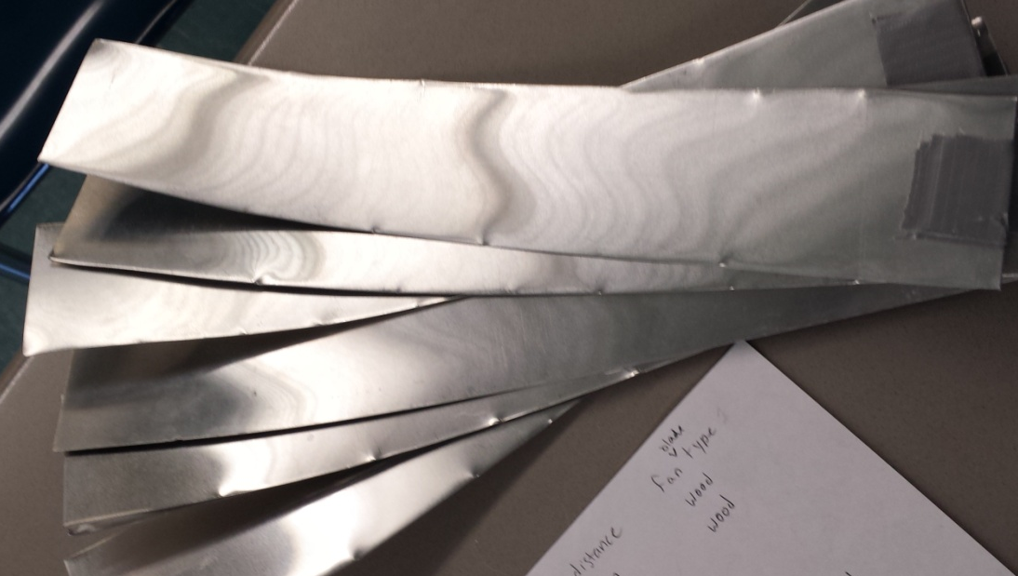
Ideate
We wanted to make two types of blades to test:
-12’ balsa wood blades
-12’ aluminum blades with curvature

Slide 6
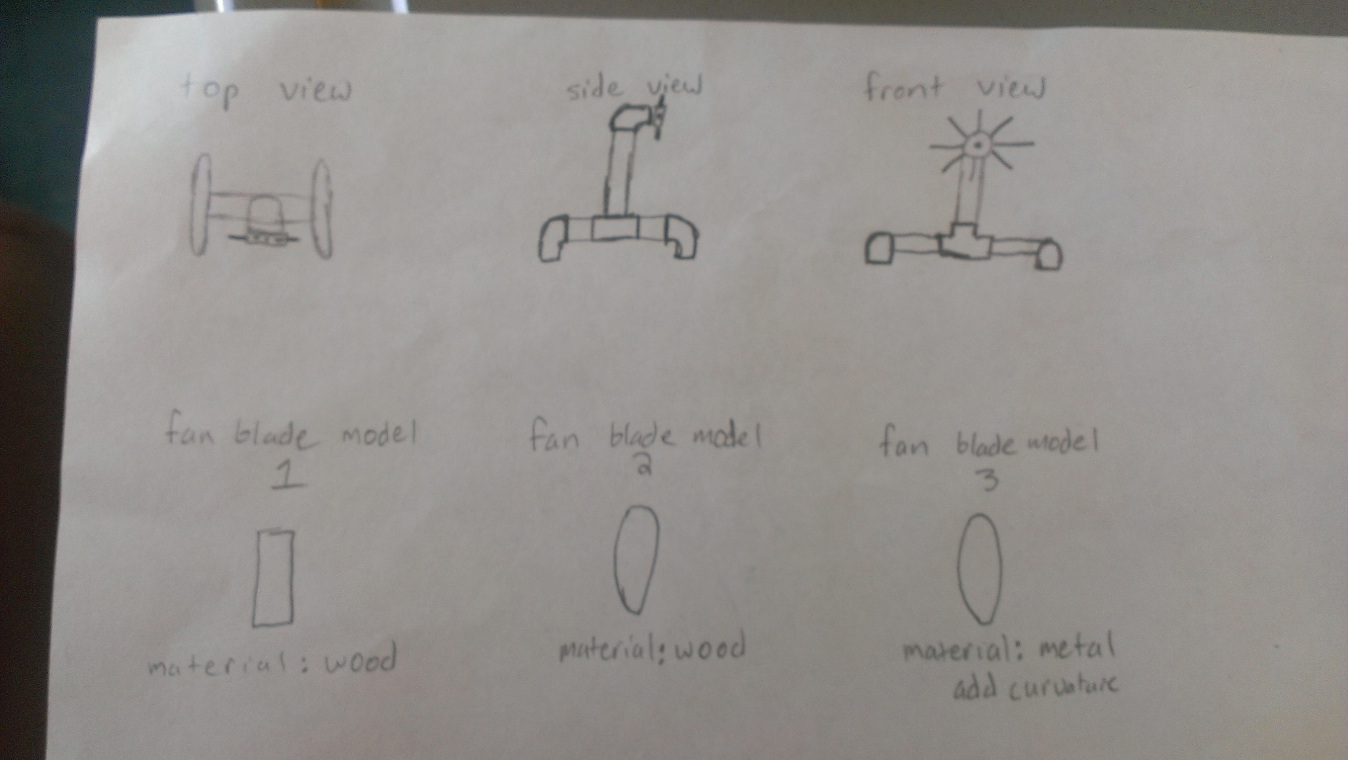
Ideate

Slide 7
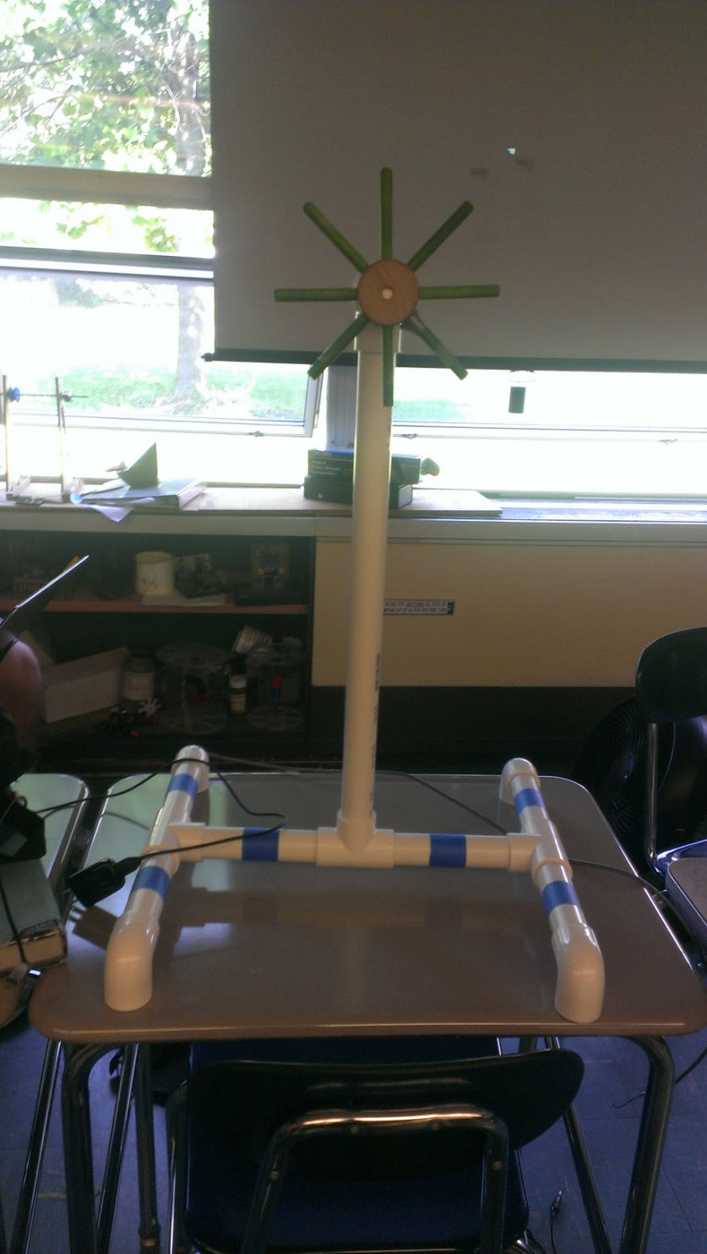
Prototype
Then we designed our prototype. We designed our wind turbine to have a simple base and a 2 foot tall pole to hold the blades.
First we attached the balsa wood and tested.
When we tried to fasten the aluminum blades onto the holders, they wouldn’t fit.

Slide 8
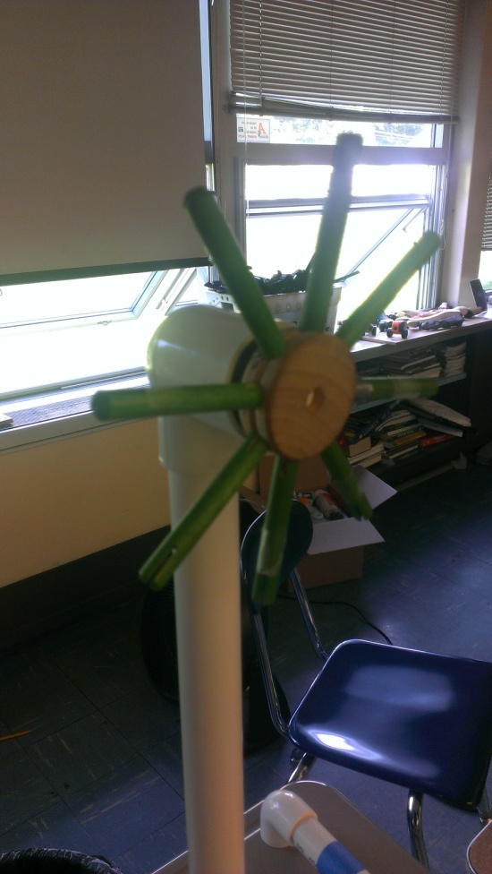
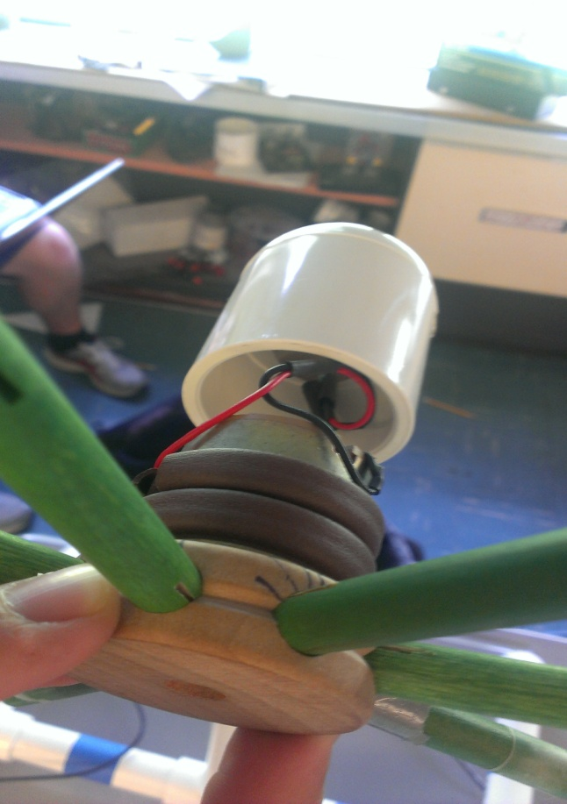
Refine
We used quite a bit of duct tape on each aluminum blade to thicken it, so that it would fit nice and snugly.

Slide 9
Solution
We found out that the aluminum blades were about twice as efficient as the balsa wood blades, despite being much heavier.

Slide 10
Solution Cont.
Fan Type | Output (mA) | Distance from fan | Fan Setting
Wood | .40 | 1.4m | 2
Wood | .48 | 1.4m | 3
Metal | .75 | 1.4m | 2
Metal | 1.41 | 1.4m | 1
Fan type | Period of rotation | Fan setting
Wood | 152 Rotations per minute | 1
Metal | 78.4 rotations per minute | 1

Slide 11
Results Observations
The metal blades took a lot longer to get to their terminal velocity than the wood blades which got to their terminal velocity within a matter of seconds
On the highest fan setting the wooden blades became disconnected from the pegs, and on setting 2 the metal blades disconnect from the system. The most efficient setting for the metal blades is setting 1 on the fan.

Slide 12
Results
We tested 2 different types of blade designs and found that the metal blades with curvature worked twice as well as the balsa wood blades with no curvature
When using the Digital Photo Sensor Tachometer, we measured that the angular velocity of the balsa wood blades was 1.3 revolution per second, and the metal blades with curvature measured 2.5 rotations per second

Slide 13
