Slide 1
Engineering Capstone Project
By: Kyle Greulach, Grant Gallagher, Ross King, and Daniel Luddeke

Slide 2
Understanding
We knew we had to do an awesome Engineering Capstone project because it was our senior year so we wanted to make it big
We had many ideas in mind but thought that building something huge would be the coolest thing to do

Slide 3
Explore
After researching a bunch of capstone projects, we decided to keep it simple and do something we sort of already knew how to do
Some of these things we already knew how to do were more upscale and bigger than the projects that we have been doing in class

Slide 4
Define
Since we had just come back from the Wright State Trebuchet Competition with poor results, we decided to try and build a bigger trebuchet
We wanted to fire something bigger than just a small squash ball
The requirement for the trebuchet is that it had to be taller than all of the people working on it

Slide 5
Ideate
The only restrictions we had on the trebuchet was that it had to be taller than anyone in the group
We thought that going to Home Depot and asking the employees exactly what materials we should use to built this massive trebuchet, so we did just that

Slide 6
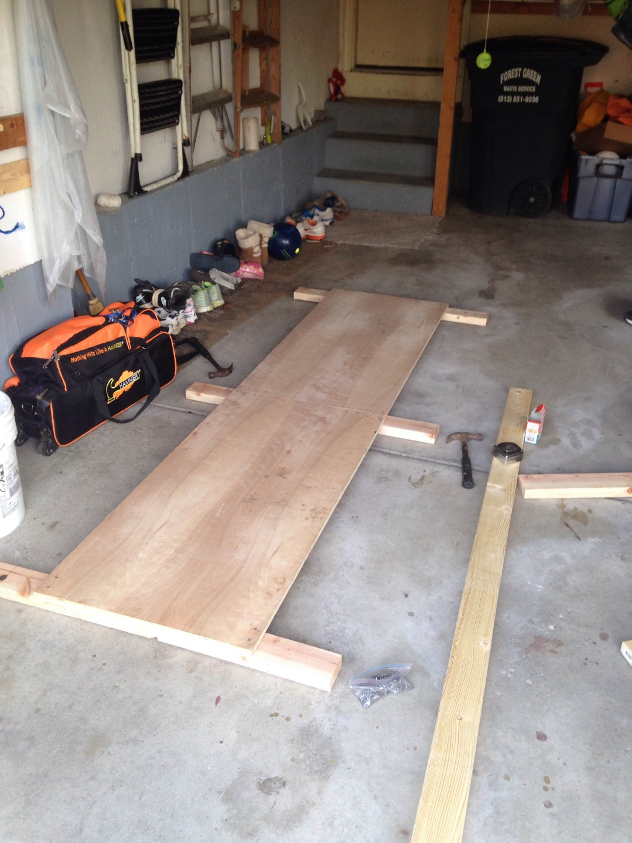
Building

Slide 7
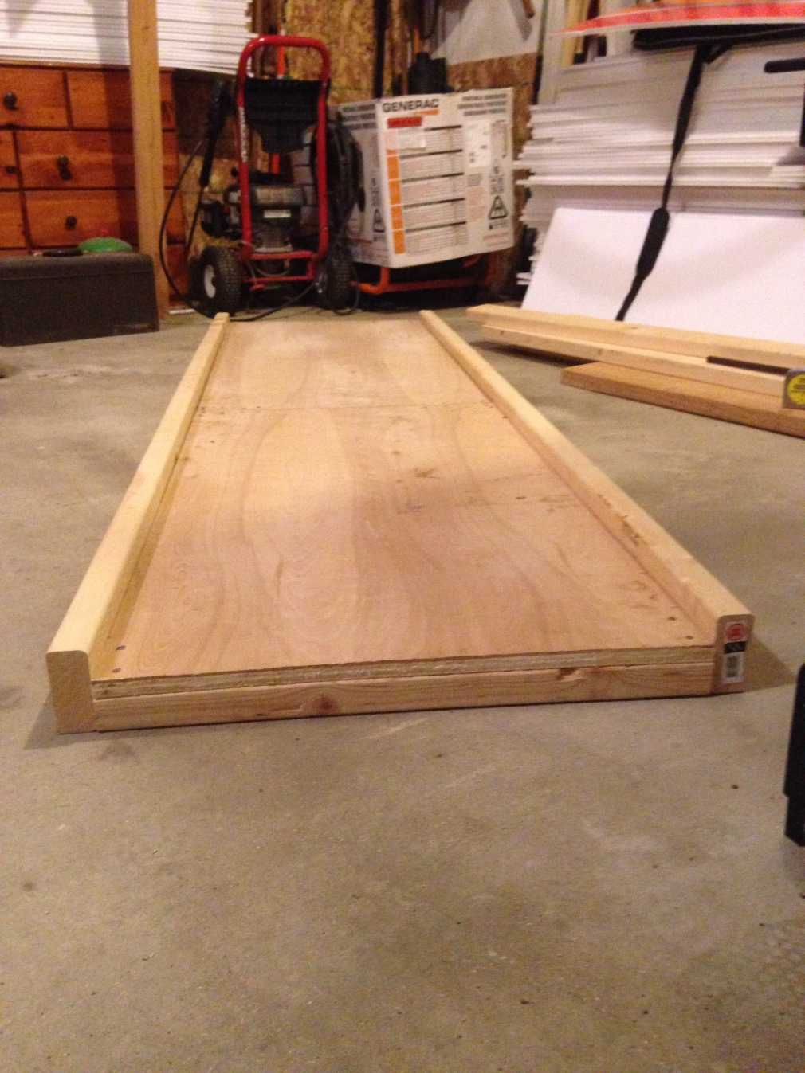
Building

Slide 8
Building

Slide 9
Building

Slide 10
Building

Slide 11
Building

Slide 12
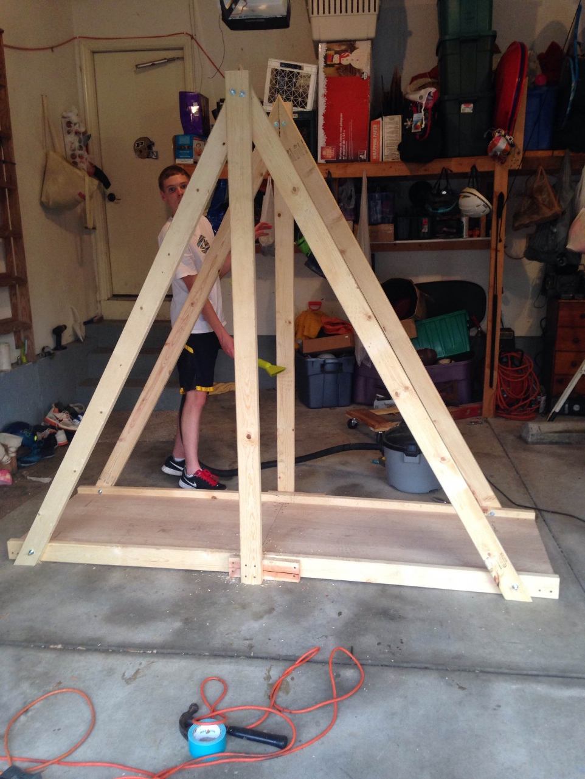
Building

Slide 13
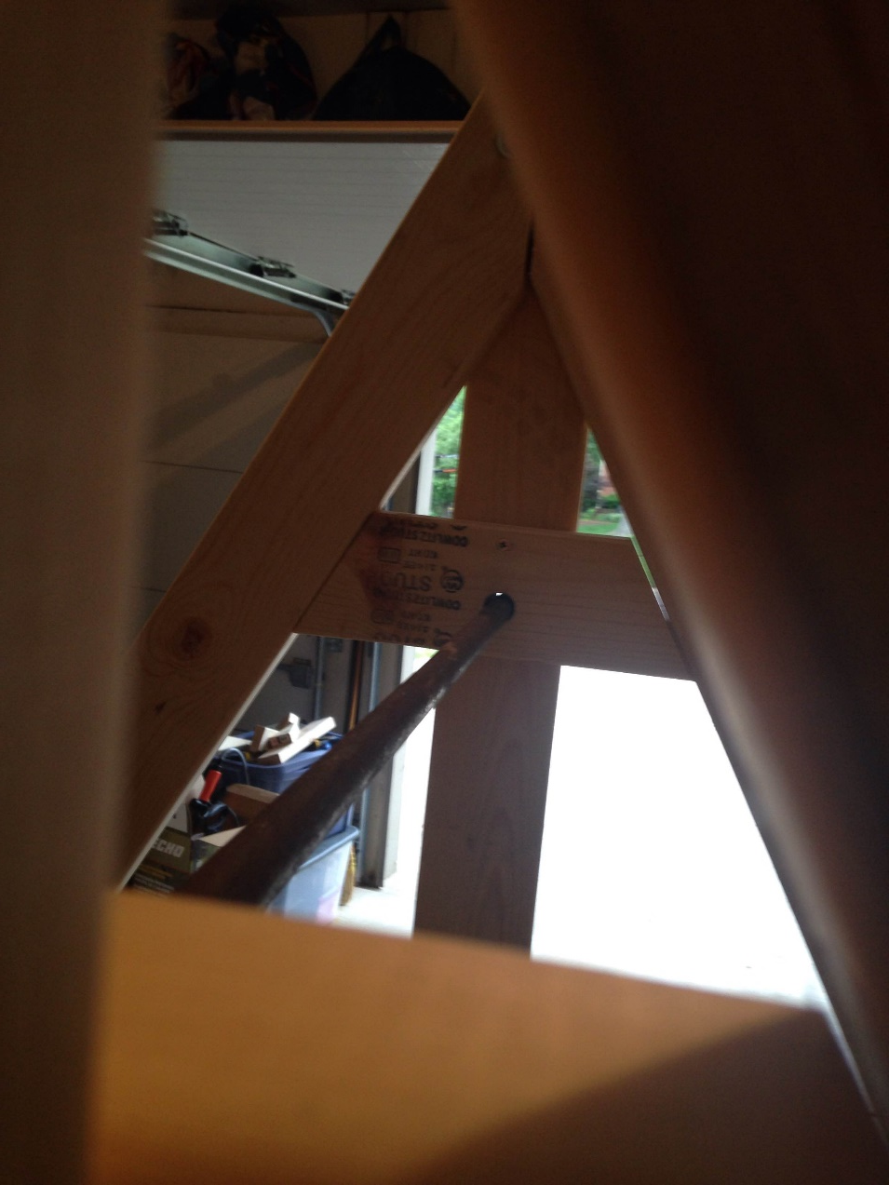
Building

Slide 14
Building

Slide 15
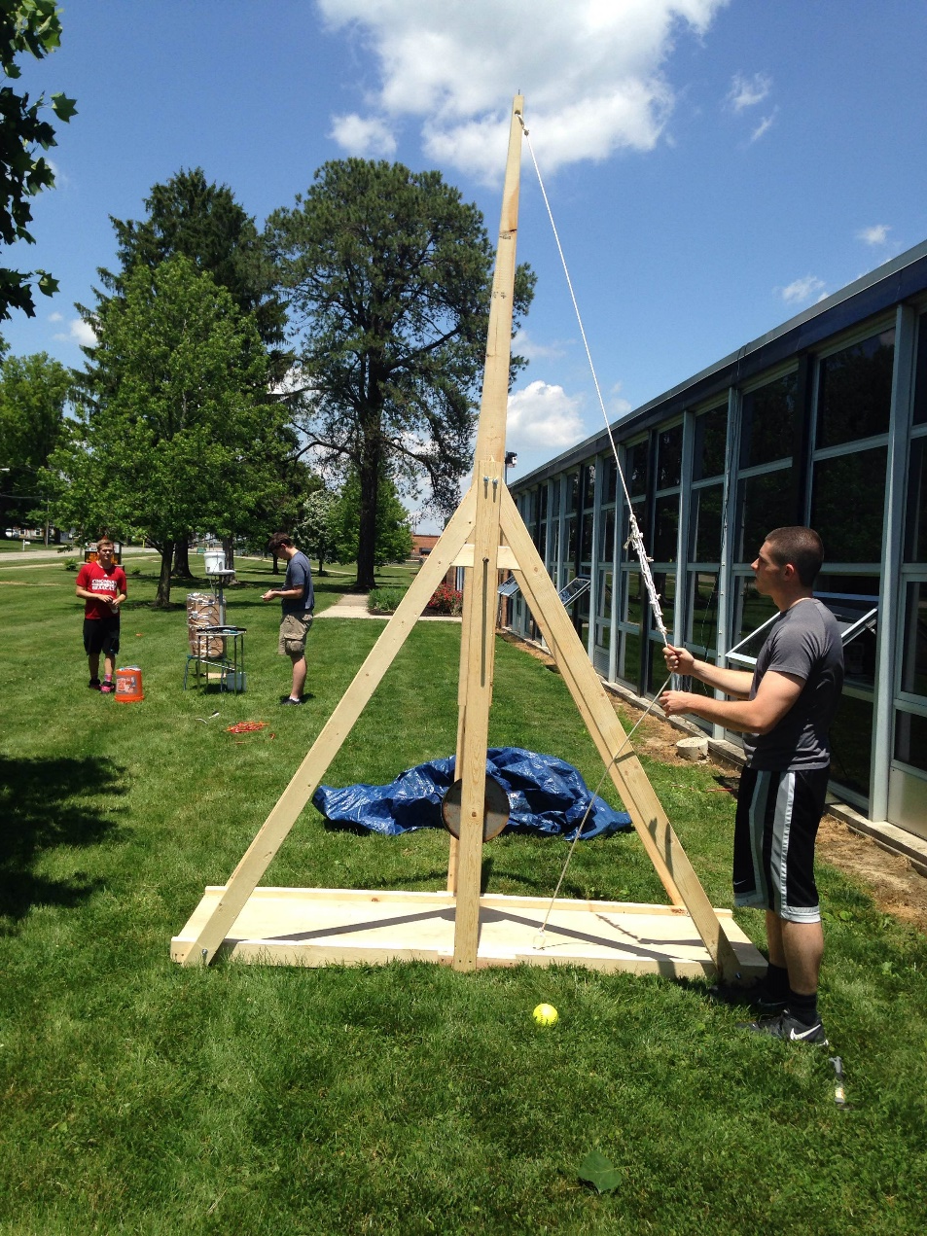
Finished Trebuchet

Slide 16
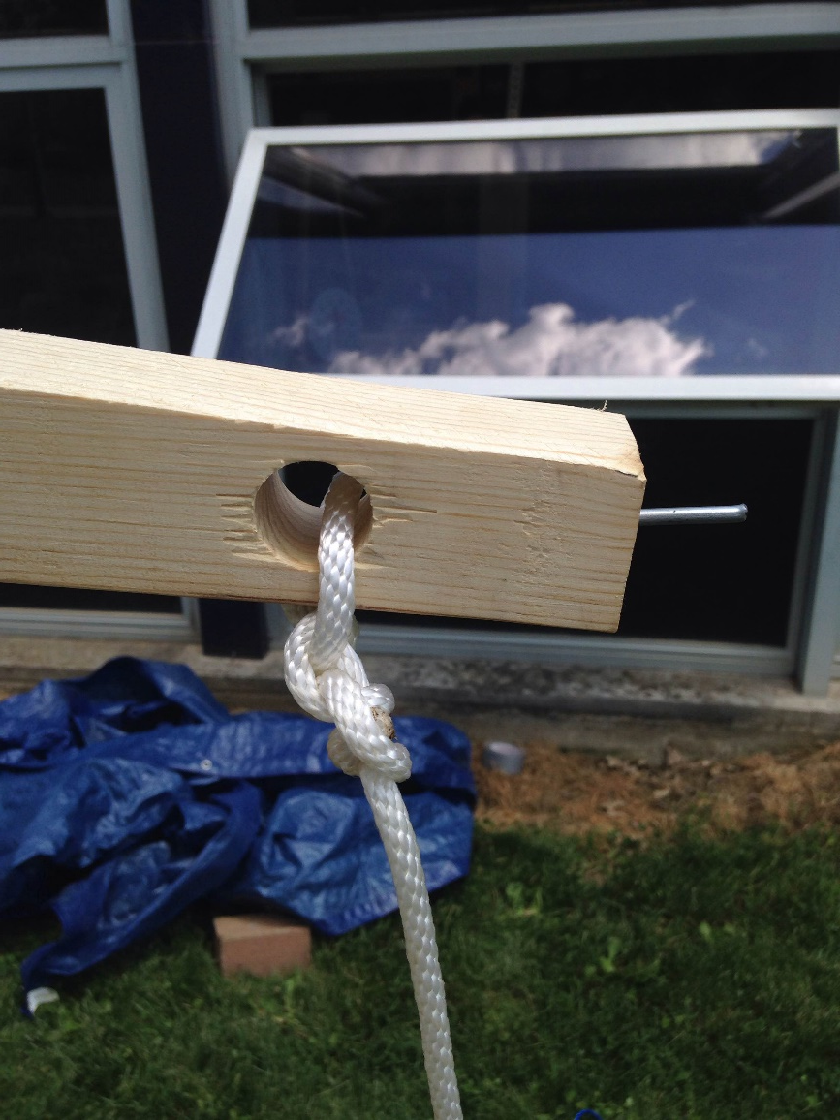
Sling

Slide 17
Axle
After using 50 lbs of counterweight, we thought it would be a good idea to try 75 lbs! But that was a bad idea……

Slide 18
The Testing
Check out the video on our website to see our test throw!

