Slide 1
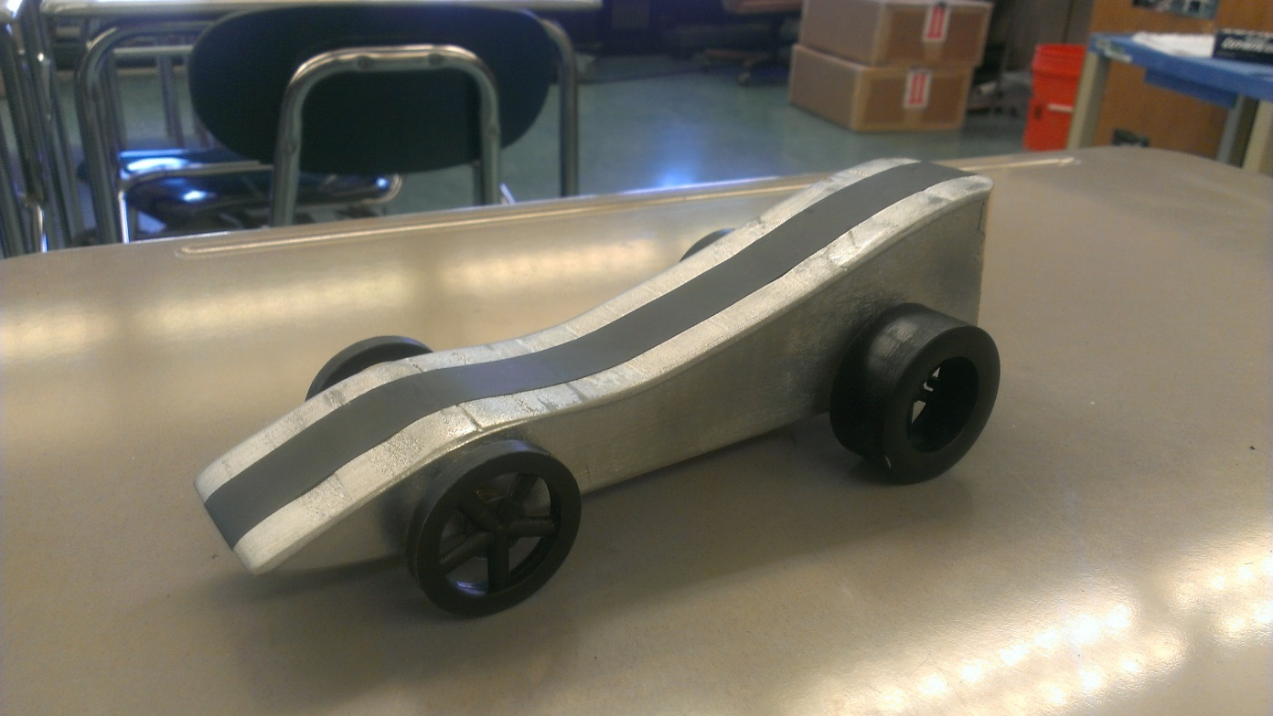
CO2 Car Project
By: Kyle Greulach and Andrew Brokaw

Slide 2
Understand
We read all the height and weight restrictions for what our car could and could not be
We thought that in the beginning that the most aerodynamic car would win
We knew we had to keep the weight low to run fast

Slide 3
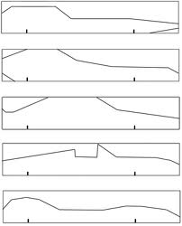
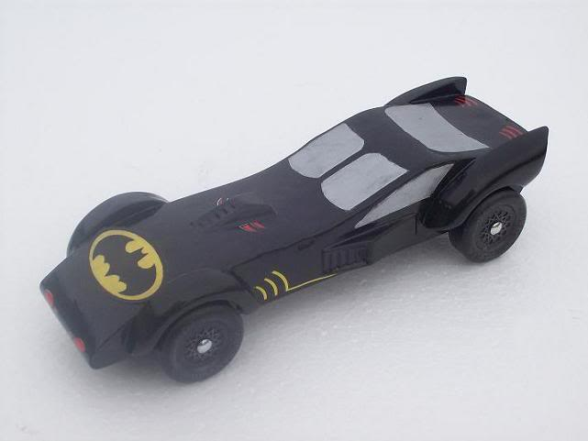
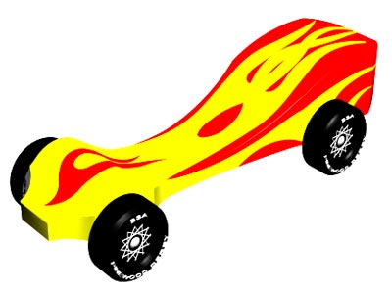
Explore
We had done some work with pinewood derby cars in the past and had had two championship winning designs from 1st-6th grade

Slide 4
Define
We wanted to go with the simplest design that we could because overthinking a design could lead to problems in the end
Our design was made up of three arcs flip-flopped and cut out off the top of the wood

Slide 5
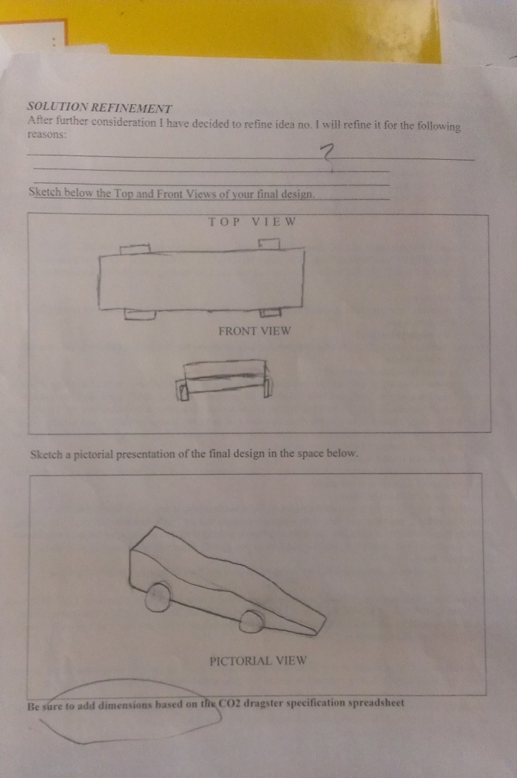
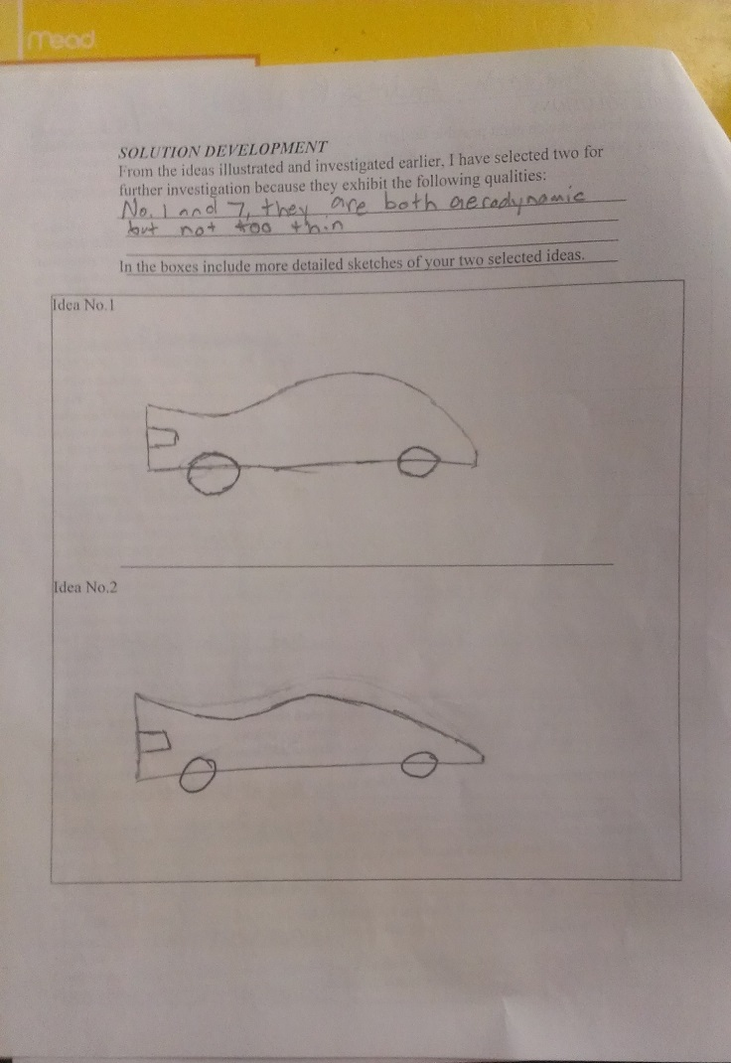
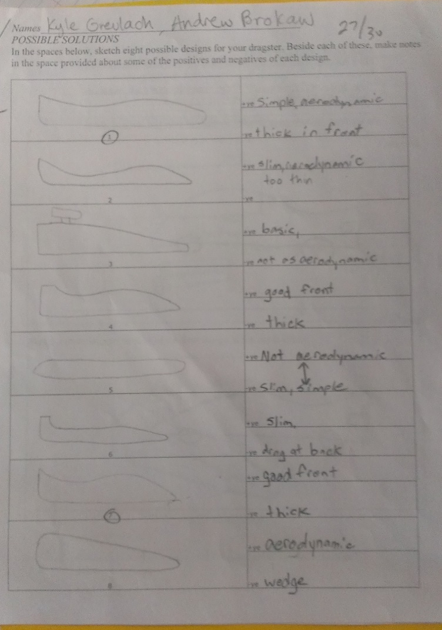
Ideate

Slide 6
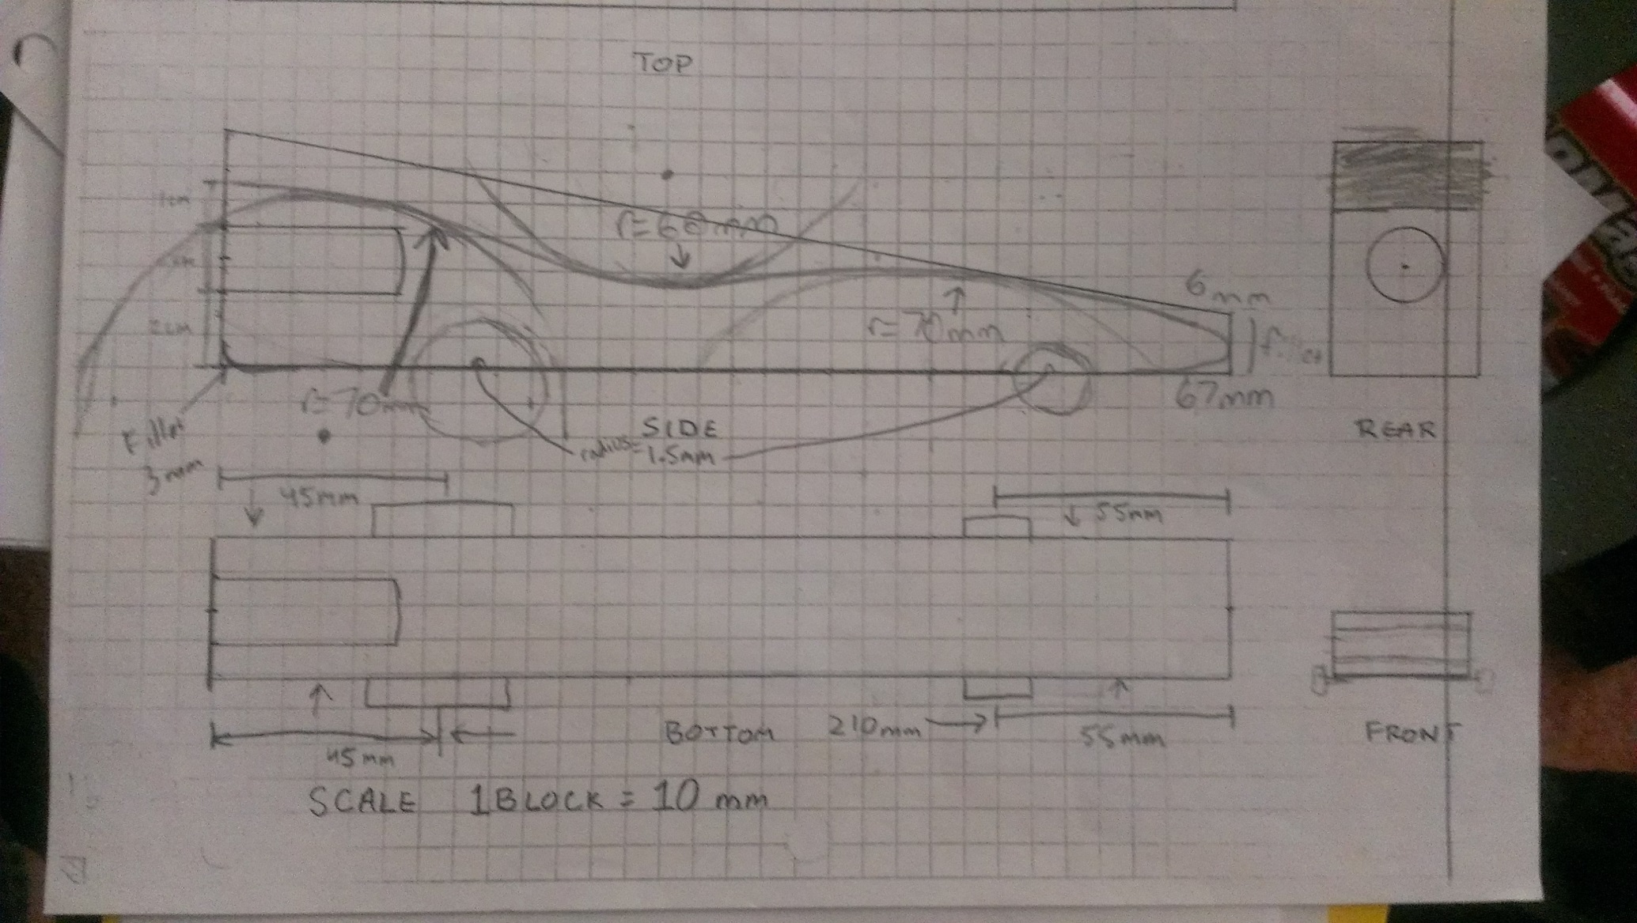
Original Blueprint

Slide 7
Inventor Images

Slide 8
Parts with Balloons

Slide 9
Dimensions

Slide 10
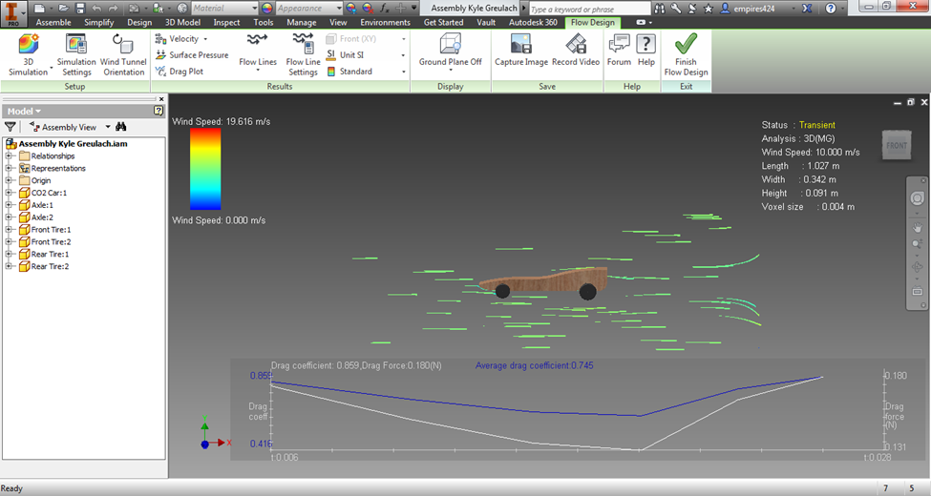
Flow Design 10 m/s – Full Car

Slide 11
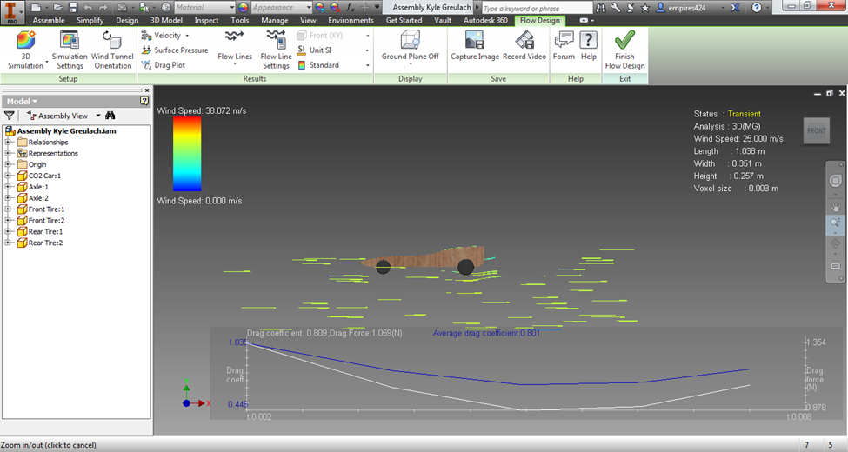
Flow Design 25 m/s – Full Car

Slide 12
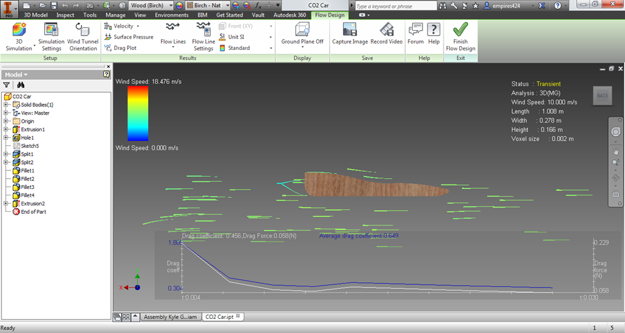
Flow Design 10 m/s – Body only

Slide 13
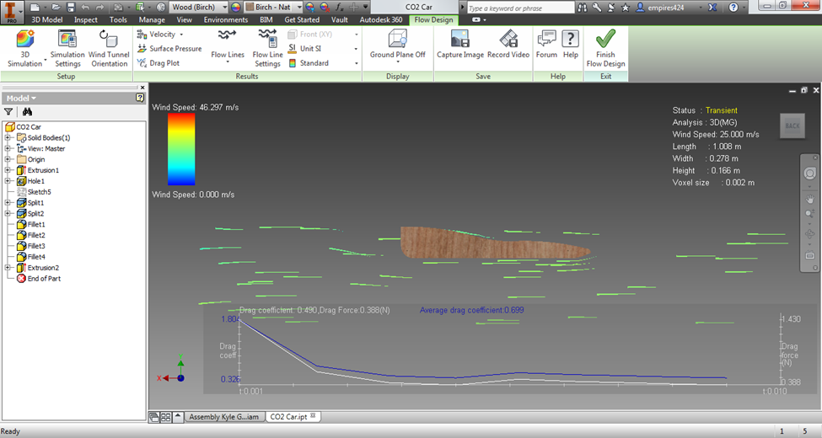
Flow Design 25 m/s – Body only

Slide 14
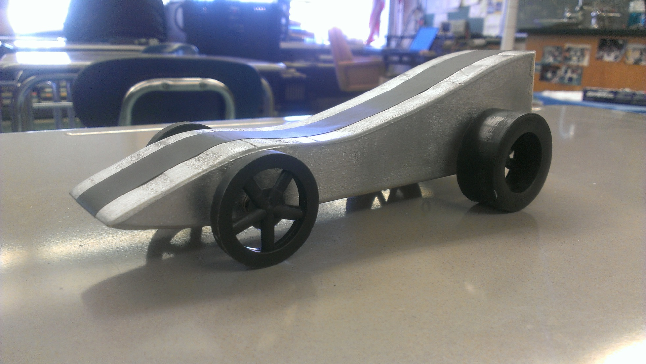
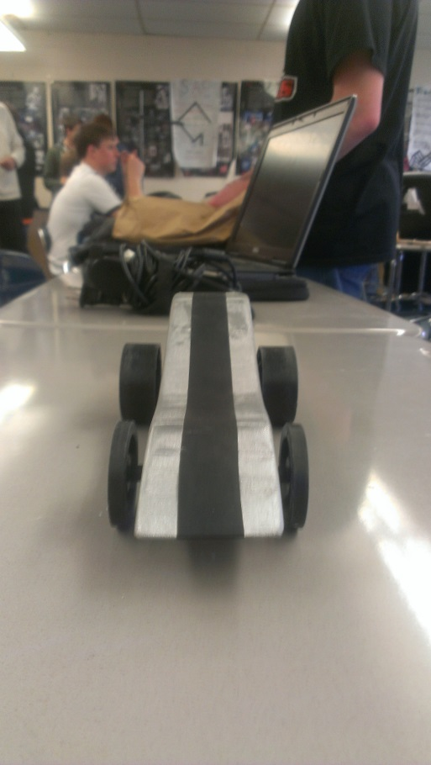
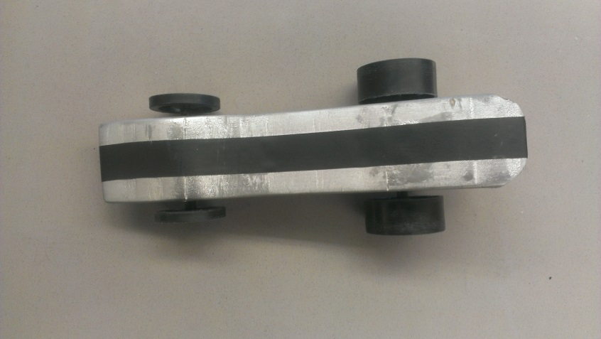
Prototype

Slide 15
Tests
Wind Tunnel Test (Cut out weight): -0.269 N
Front Wheel Test: 7.7 seconds
Back Wheel Test: 10.1 seconds
First Run: 2.343 seconds
Last Run: 1.813 seconds

Slide 16
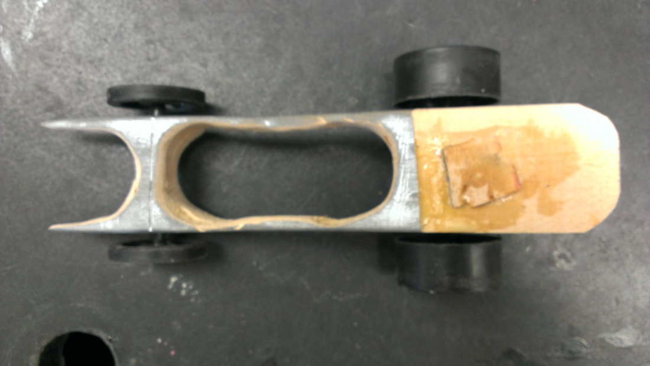
Refine
After we saw our car and all the others cars run for the first time, we concluded that the weight is a big factor in racing CO2 cars. We decided to cut the weight down progressively. In the end, we went all the way from 129 grams to 73 grams in weight and our car was a whopping 0.5 seconds faster. Although it was less way less aerodynamic, it weighted less and made up for it.

